Slide 1
IN2002 Data Structures and Algorithms
Lecture1 - Introduction
Dr Cristina Gacek
Term 1, 2025/26

Slide 2
Learning Objectives (for this lecture)
Have a common understanding of basic concepts
Algorithms, data structures, computational complexity
Understand recursive algorithms
What it means for an algorithm to be recursive
How to analyse a recursive algorithm in terms of time and space complexities
Abstract data types
What they are
How they are implemented

Slide 3
Basic Concepts Discussion

Slide 4
Basic Concepts
What are Algorithms and Data Structures?
Describing an algorithm
Properties of algorithms
Data structure: static arrays
Algorithm type: search

Slide 5
Data Structures and Algorithms
System
Representation
Data structures
Algorithms
Abstraction
Task
Reality

Slide 6
Describing an Algorithm: Pseudocode Syntax*
Title with function/method name and arguments
Sequence control in capitals:
– WHILE
– IF/THEN/ELSE
Function foo(array):
bar ← 0, i ← 1
WHILE i <= length of array
bar ← bar+ 2*array[i]
i ← i + 1
Return bar
Indent to indicate scope
Arrow for assignment (can be typed “<-”)
* See Introduction to Algorithms lecture notes

Slide 7
Another Example
Title with function/method name and arguments
Function foo2(array):
bar ← 0, i ← 1
WHILE i <= length of array
IF array[i] = 0 THEN
bar ← bar + 1
ELSE
array[i] ← 0
i ← i + 1
Return bar
Sequence control in capitals:
– WHILE
– IF/THEN/ELSE
Indentation indicates scope
Arrow for assignment (can be typed as “<-”)

Slide 8
Data Structures
Data structures are ways of organising data.
They should
represent all relevant information
use little memory
support efficient algorithms

Slide 9
A simple data structure: a static array
Built into most programming languages
A finite set of elements
The elements are in a fixed sequence
Elements can be addressed by indices (Pseudocode, Mathematics, Pascal) or offsets (Java, C, C++)
26
3
7
13
9
5
17
4
index
1
2
3
4
5
6
7
8
offset
0
1
2
3
4
5
6
7
Notes:
Offset ??

Slide 10
Devising programmes to solve problems
… is a combination of identifying the most suitable
data structure to contain the data
algorithm to accomplish the task
Not all combinations of data structures and algorithms work
A given combination of data structure and algorithm may be ideal for one situation, yet not the best for another
Notes:
No way of saying the only one way is the best solution ….

Slide 11
An algorithm example
What does foo do? *
Function foo(array):
bar ← 0, i ← 1
WHILE i <= length of array
bar ← bar + 2*array[i]
i ← i + 1
Return bar
* From slide 6

Slide 12
Another algorithm example
What does foo2 do? *
Function foo2(array):
bar ← 0, i ← 1
WHILE i <= length of array
IF array[i] = 0 THEN
bar ← bar + 1
ELSE
array[i] ← 0
i ← i + 1
Return bar
* From slide 7

Slide 13
Computational Complexity Discussion

Slide 14
Computational Complexity
Description of the resources needed by an algorithm:
Complexity in
(running) time or
(memory) space
Best, worst and average cases
Representation by growth
Notes:
Why ??

Slide 15
Common types of complexity *
constant: O(1)
logarithmic: O(log n) good
linear: O(n)
quadratic: O(n²) acceptable (sometimes)
cubic: O(n³)
polynomial: O(n^{k})
exponential: O(a^{n}) intractable
factorial: O(n!)
* See Introduction to Algorithms lecture notes

Slide 16
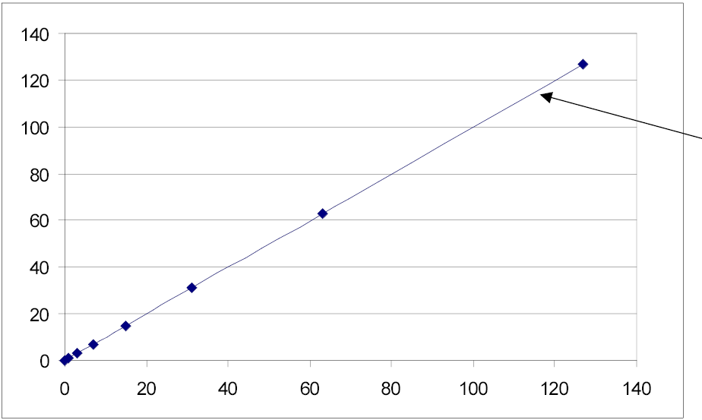
Sequential search is linear (time complexity)
number of loops
array length
O(n)

Slide 17
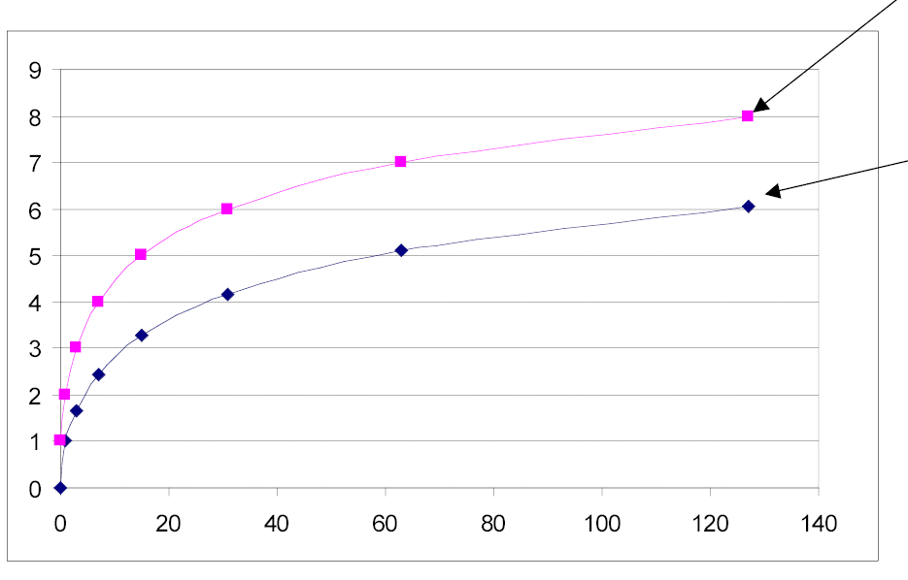
Binary search is logarithmic (time complexity): O(log n)
log(n)+1
worst case
average
array length
loops

Slide 18
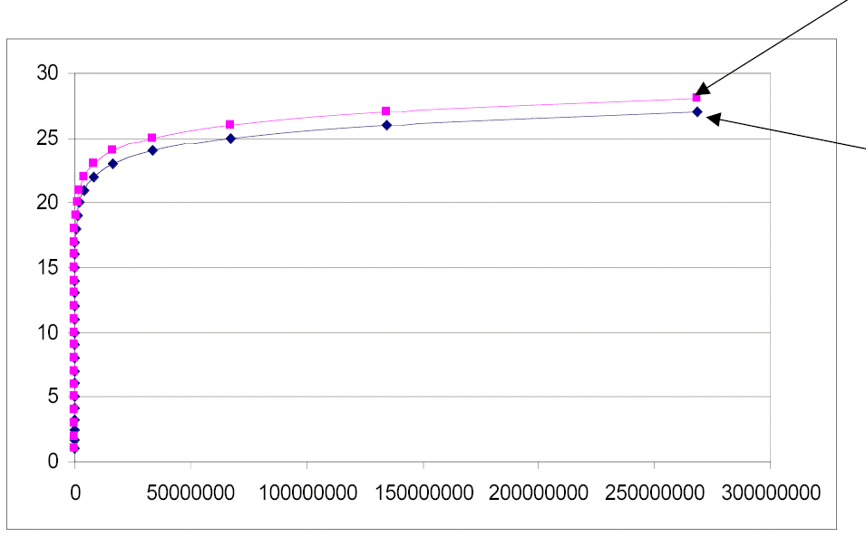
Binary search is logarithmic: O(log n)
log(n)+1
worst
average
array length
Note how flat the graph gets for large numbers.
loops

Slide 19
Finding the order of complexity
Function binary_search(array, key)
lo← 1, hi ← length of array
WHILE lo ≤ hi
mid ← (lo + hi) / 2
IF key < array[mid] THEN
hi ← mid - 1
ELSE
IF key > array[mid] THEN
lo ← mid + 1
ELSE
Return mid
Return -1

Slide 20
Examples of code complexity analysis
Function foo3(array):
sum ← 0, c ← 1
WHILE c <= length of array
c1 ← 1
WHILE c1 <= length of array
sum ← sum + array[c] * array[c1]
c1 ← c1 + 1
c ← c + 1
Return sum

Slide 21
For you to try later…
Other examples of complexity code analysis *
Function foo(array):
bar ← 0, i ← 1
WHILE i <= length of array
bar ← bar+ 2*array[i]
i ← i + 1
Return bar
* From slides 6 and 11

Slide 22
… and another one *
Function foo2(array):
bar ← 0, i ← 1
WHILE i <= length of array
IF array[i] = 0 THEN
bar ← bar + 1
ELSE
array[i] ← 0
i ← i + 1
Return bar
* From slides 7 and 12

Slide 23
Recursion

Slide 24
Divide and Conquer
Many algorithms have the form:
If the input is not simple, divide the input into simpler components, apply the algorithm recursively to each part, and combine the results obtained
Otherwise, solve it with a special algorithm

Slide 25
Analysing divide and conquer algorithms
You have to consider, for an input size of n:
If the input is simple
the time the special algorithm takes
Otherwise,
the time of dividing the input, plus
the time of processing the components, plus
the time of combining the results
... and then solve the recursive definition.

Slide 26
Recursion *
A powerful way of programming using a function within itself
A problem is addressed by identifying:
A step towards the next simpler case to which the same approach applies
AND
Result in the simplest case
Recursion is, in a way, the reverse of proof by induction
* Introduced to you in Introduction to Algorithms

Slide 27
Example: Factorial
Problem: calculate n! = n·(n-1)·(n-2)·...·1
Step (for n>0): n! = n·(n-1)!
Base (simplest) case: 0! = 1
This defines the value of n! for any natural number n.
Function factorial(n)
IF n = 0 THEN
Return 1
ELSE
aux ← factorial(n-1)
Return n * aux
// 0
// 1
// 2
// 3
// 4

Slide 28
What are “factorial’s” time and space complexities?
Time complexity
Space complexity

Slide 29
Tail Recursion
void tail(int i) {
if (i > 0) {
System.out.println(i);
tail(i-1);
}
}
void tailloop(int i) {
while (i > 0) {
System.out.println(i);
i=i-1;
}
}
Tail recursion is when the recursive call is the last thing done.
A loop can easily replace it.

Slide 30
Example of Tail Recursion: factorial
This factorial function is tail-recursive:
int factorial(int n) {
return fact(n, 1);
}
int fact (int n, int product) {
if (n == 0){
return product;
}
return fact(n-1, n*product);
}

Slide 31
... Tail Recursive factorial
int fact (int n, int product) {
if (n == 0)
return product;
return fact(n-1, n*product);
}
int fact(int n, int product) {
while(n>0) {
product = n*product;
n = n-1;
}
return product;
}
And can easily be converted into iterative (i.e. a loop).

Slide 32
Why Use Tail Recursion?

Slide 33
Another Example of Recursion
What does this function do?
void printNum(int n) {
if (n >= 10){
printNum(n/10);
}
System.out.print(n%10);
}

Slide 34
What are “printNum’s” time and space complexities?
Time complexity
Space complexity

Slide 35
Another example for recursion (exam 2019-20)
Complexity Analysis, Circular List & Recursion (20%)
You are given the pseudocode for the bla method below, where a circular list of n nodes is
Function bla (CList t) IF t != NULL IF t.next = t Return 1 ELSE t.next <- t.next.next Return 1 + bla(t) ELSE Return 0
a) Describe what bla does. (10%)
b) What is its time complexity? Justify your answer. (5%)
c) What is its space complexity? Justify your answer. (5%)

Slide 36
Applications of Recursion
Recursion is useful for:
designing algorithms
traversing branching structures (like trees and graphs)
writing parsers
backtracking search algorithms
divide-and-conquer algorithms

Slide 37
Pros and Cons of Using Recursion
Pros
often elegant solutions
compact code
proving correctness often relatively easy
Cons
careful algorithm design necessary
hard to debug (better prove correctness)
function call stack needs extra memory and is often limited

Slide 38
Common Computations
Why do we often discuss sorting algorithms?
What are examples of sorting algorithms?
How fast are they?

Slide 39
Sorting Algorithms
 | Space complexity | Average time complexity | Worst case time complexity
Selection sort | O(1) | O(n²) | O(n²)
Insertion sort | O(1) | O(n²) | O(n²)
Quicksort | O(log n) | O(n log n) | O(n²)
Mergesort | O(n) | O(n log n) | O(n log n)

Slide 40
Other Common Computations
How about searching?
Insertion?
Deletion?

Slide 41
Deletion Algorithm
• How do we delete an element of an array?
• What if the array is sorted?
• How often do we need to delete elements?

Slide 42
Food for Thought (Arrays)
• Should we always use arrays to store and manipulate our data?
• Should we always sort their contents?

Slide 43
Abstract Data Types

Slide 44
Abstract Data Types (ADTs)
Abstract data types
separate functionality from implementation
hidden representation
manipulated via a limited set of operations
in Java, interfaces with defined method semantics
Data structures
concrete implementations, often subject to an invariant preserved by the operations
in Java: classes implementing ADT interfaces
are analysed by measuring the time and space complexity of the structure and each operation

Slide 45
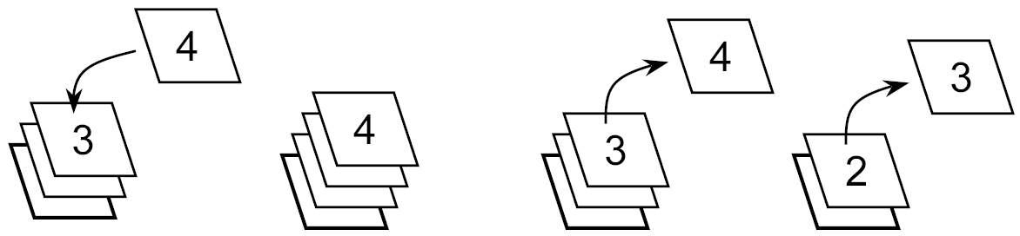
ADT Stack
Think of physical stacks:
series of similar elements
you add elements on the top
you take the elements from the top
... so the last element in is the first out (LIFO)

Slide 46
Stack Operations
You can only remove the last element added.
The operations are thus:
Add an element to the stack
Remove the last element added
Check whether the stack is empty.

Slide 47
A stack in Java
// a stack of integers
public interface Stack {
// is the stack empty?
boolean isEmpty();
// add (push) an element into the stack
void push(int elt);
// remove and return the most recently pushed
// element still in the stack
int pop();
}

Slide 48
A stack implementation using an array (sketch)
public class ArrayStack implements Stack {
private int[] a;
private int count = 0;
public ArrayStack(int size) {a = new int[size];}
public boolean isEmpty() { return count == 0; }
public void push(int elt) { a[count++] = elt; }
public int pop() { return a[--count]; }
}

Slide 49
An example of stack use
Problem: Checking Matching Brackets with a Stack
opening bracket: push on stack
closing bracket: pop from stack and match
String Stack Op
( [ ] ( [ ) ] ) push [ ] ( [ ) ] ) ( push
] ( [ ) ] ) [(
( [ ) ] ) (
[ ) ] ) ((
) ] ) [((

Slide 50
Food for Thought
• Why do we care about Abstract Data Types?

Slide 51
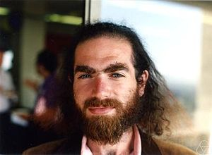
Do you know who this person is?
Grigori Perelman

Slide 52
Reading
For visualisations check Linear and Binary Search on:
https://www.cs.usfca.edu/~galles/visualization/Search.html
Weiss: Chapter 5, chapter 7, and chapter 15 section 1.1
Drozdek: Chapter 2, chapter 5, and chapter 4 sections 4.1and 4.3
Next week: Priority Queues, Trees, Heaps and Queues

Slide 53
Department’s contact info
City St George’s, University of London
Northampton Square
London
EC1V 0HB
United Kingdom
T: +44 (0)20 7040 6051
E: ug.cs@city.ac.uk
www.city.ac.uk/about/schools/science-technology/computer-science

